Slide 1
Online Learning Environment Comparison
Sarah Anderson
Casey Krogman
Marilyn Weidenbach

Slide 2
“A simple question to ask is, ‘How has the world of a child changed in the last 150 years?’ And the answer is, ‘It’s hard to imagine any way in which it hasn’t changed.’ Children know more and what’s going on in the world today than their teachers, often because of the media environment they grow up in. They’re immersed in a media environment of all kinds of stuff that was unheard of 150 years ago, and yet if you look at school today versus 100 years ago, they are more similar than dissimilar.”
--Peter Senge, senior lecturer at the Massachusetts Institute of Technology (Partnership)

Slide 3
Basic Description of Online Learning Environments
“a system designed to support teaching and learning in an educational setting (Wikipedia)”
An online learning environment is a system of tools used to present content materials either in an entirely online-based class or additional information to students in a face-to-face class.

Slide 4
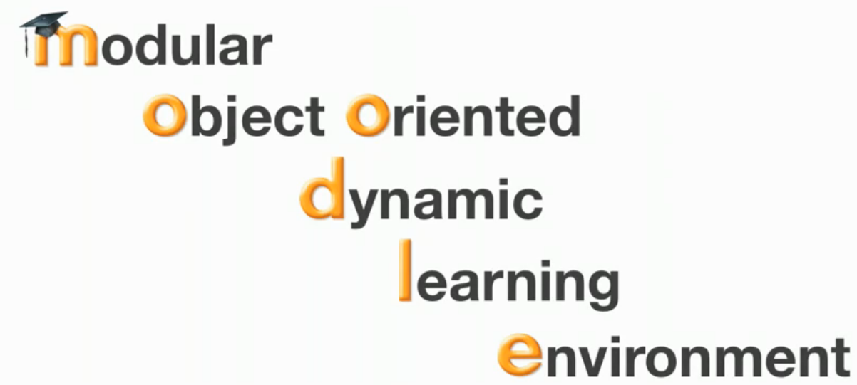
Moodle
Moodle (n.d.) Retrieved from http://moodle.org/

Slide 5
Moodle is a free software package used for creating Internet-based classes or websites often known as a Virtual Learning Environment (VLE).
It uses Open Source software that is free as long as the user agrees to the license.
Moodle can be run on Windows, Mac, and even many Linux based computers.
Moodle (n.d.) Retrieved from http://moodle.org/

Slide 6
Ways to use Moodle
Moodle can be used to teach online courses or supplement regular classes.
It can be used in at most grade levels including elementary.
Moodle allows the designer to use forums, databases, wikis, and give quizzes or tests.
Moodle (n.d.) Retrieved from http://moodle.org/

Slide 7
Ways to use Moodle
Moodle allows a new delivery of activities as well as a way for students to publish their work in a safe environment.
The teacher is able to communicate with students. Students are able to collaborate even though they may not ever meet in person.
Moodle (n.d.) Retrieved from http://moodle.org/

Slide 8
Moodle for Special Needs Students
Moodle Supports
Screen Readers
Screen Magnifiers
Alternative Mouse/Key Use
Disabling of AJAX and Java
All of these tools with help students with special needs such as:
Learning Disabilities
Visually Impaired
Autism
Other Health Impairments (ADD/ADHD)
Moodle (n.d.) Retrieved from http://moodle.org/

Slide 9
Moodle in K-12
Moodle can be used in the K-12 environment. There is a forum dedicated specifically to this group of teachers.
Moodle can be used in a variety of subjects: Math, Language Arts, Foreign Languages, Science, Social Studies, etc.
Moodle also has a grading section. This allows for the teacher to give feedback or students to receive instant feedback in some situations.
Moodle (n.d.) Retrieved from http://moodle.org/

Slide 10
Student Communication
The teacher can communicate with students using:
Forums
Private message channels
Chat rooms for synchronous conversations
Assignment feedback
Blogs
Moodle (n.d.) Retrieved from http://moodle.org/

Slide 11
Sharing Content
Teachers can share content using:
Files or folders
Attaching files to forums
Importing or linking resources from other websites
Moodle (n.d.) Retrieved from http://moodle.org/

Slide 12
Technology Skills Students Need
Students need to be able to log into the Moodle site.
Students also need to have some basic computer skills such as:
Attaching or downloading a file
Working links
Using the internet
Moodle (n.d.) Retrieved from http://moodle.org/

Slide 13
School Town
School Town (n.d.) Retrieved from http://schooltown.net

Slide 14
School Town
School Town is a web-based learning environment that is offered as a subscription service.
This service was designed to be blended with classroom learning in the K-12 area.
In addition to discussion boards, instant messaging, and curriculum links, School Town offers professional development and training for teachers.
School Town (n.d.) Retrieved from http://schooltown.net

Slide 15
Ways to use School Town
School Town is designed to be used as a supplement to learning within the classroom.
It can be used in at most grade levels including elementary.
School Town allows the teacher to create assignments, discussion topics, and events.
School Town (n.d.) Retrieved from http://schooltown.net

Slide 16
Benefits of School Town
School Town provides a variety of tools that allows personalization for each student.
Student feedback can be given in a timely fashion for each student.
The parent portal allows parents to check student’s assignments and teacher comments.
School Town (n.d.) Retrieved from http://schooltown.net

Slide 17
Benefits of School Town
Online professional development allows teachers to ‘attend’ when it is convenient for them.
Organizational tools assist students in getting organized.
Students can access resources from home or school and set goals in a safe envirnonment.
School Town (n.d.) Retrieved from http://schooltown.net

Slide 18
Features for Teachers
To assist teachers in using School Town, there is an online professional development course: “Getting Started with School Town.”
Teachers may create assignments and reports based on grades.
There is also a calendar to assist students and teachers with organization.
School Town (n.d.) Retrieved from http://schooltown.net

Slide 19
Features for Students
Students have the ability to chat, blog, set goals and complete assignments.
Students have access to multiple sources of information to provide for interactive learning.
Students can collaborate on projects anytime and anywhere.
School Town (n.d.) Retrieved from http://schooltown.net

Slide 20
Features for School Districts
Parents may also log in and check their student’s grades and work.
Interactive links allow students to continue learning at home.
Students are only connected to teachers and other students invited by the teachers.
Online professional development courses allow teachers to both gain and practice 21st century skills.
School Town (n.d.) Retrieved from http://schooltown.net

Slide 21
Requirements for Promoting Meaningful Learning
The Partnership for 21st Century Skills (SEDTA, n.d.) identifies 4 key areas of skills students need to have in order to have a meaningful education in today’s society:
“21st Century Content (e.g., global awareness)
Learning and Thinking Skills (e.g., collaboration, creativity)
Information and Technology Literacy
Life Skills (e.g., Leaderships, Adaptability)”

Slide 22
Requirements for Promoting Meaningful Learning
The Partnership for 21st Century Skills also suggests teachers help students create meaningful connections to what they learn in school by:
“Making content relevant to students’ lives;
Bringing the world into the classroom;
Taking students out into the world;
Creating opportunities for students to interact with each other, with teachers and with other knowledgable adults in authentic learning experiences (Partnership, n.d.)”

Slide 23
Promoting Meaningful Learning: Moodle
Moodle allows teachers to make content relevant to students’ lives and bring the world into the classroom through links to outside resources and assignments
Students can also go out into the world using outside links as well as wikis and other communication tools
Moodle also makes it possible to bring in outside experts using technology

Slide 24
Promoting Meaningful Learning: Moodle
Moodle also promotes online learning by allowing students to work together or independently using 21st Century Skills such as:
Collaboration, Digital Entrepreneurship and Critical Thinking Skills
Students are able to publish their work and share it with people around the world.
Students will learn the tools available to find answers and if they are reliable.

Slide 25
Promoting Meaningful Learning: School Town
School Town allows teachers to create links to multimedia and other resources on the internet so students have the opportunity to become familiar with 21st century content and build information and technology literacy
School Town’s features also allow students to practice life skills like time management, setting goals and leadership

Slide 26
Promoting Meaningful Learning: School Town
The ability to link different types of resources to lessons and activities allows teachers to make the content relevant to students’ lives and bring the world into the classroom
Blogs, messaging, wikis, and chat features allow students to interact with each other and other people in the world

Slide 27
Attention to 21st Century Learning Skills
A 21st century learning environment is one that embraces interactive learning, higher-level thinking skills, and student collaboration (SETDA n.d.).
21st century learning skills include those in information & communications, critical thinking & problem solving, interpersonal, collaborative & self-directional skills, goal setting, time management, self-assessment, social responsibility, and digital entrepreneurship (Jukes, McCain, 2007)

Slide 28
Attention to 21st Century Learning Skills: Moodle
Information and communication
Resources can be built into Moodle courses using links and attachments
Collaborative
Students and teachers can use forums, messaging, chat, and comments to communicate with each other
Critical thinking
Uploaded activities and resources allow students to work together to answer questions

Slide 29
Attention to 21st Century Learning Skills: Moodle
Self assessment
The workshop module allows students to evaluate and rate each other’s work
Digital entrepreneurship
Students are able to use Moodle to create projects and assignments
Time management
Various available modules and plug-ins can be added to the course site such as calendars and reminders

Slide 30
Attention to 21st Century Learning Skills: School Town
Collaborative and self-directional skills
Allows students to work together on assignments and keep track of assignments
Goal setting
School Town has a specific goal setting feature for students
Time management
Features a calendar and allows users to set up events for assignments and due dates

Slide 31
Attention to 21st Century Learning Skills: School Town
Information & communications
Students and teachers are able to communicate using chat, blogs, and discussion boards
Interpersonal
Students can work in groups using discussion boards and chat features

Slide 32
Improved Learning Environment
Moodle and School Town both provide teachers the opportunity to use project-based learning or the partnering pedagogy.
Students are able to work in groups to answer real world questions. This will be done through large projects where students research information to teach themselves and answer the question. (Prensky 2010.)

Slide 33
Improved Learning Environment
Students need to know how to research and find answers on their own to become active, independent learners.
Students also need to learn what tools they have available as resources so they can then use those tools when they have questions.
Online learning environments such as Moodle and School Town provide such learning activities since they can be used as online only classes or supplements for face-to-face classes.

Slide 34
Improved Learning Environments
Improved learning environments follow the new Bloom’s Taxonomy where the highest level of thinking is creating instead of evaluation (Churches 2008.).
Prensky says it is the students job to use technology. Learning environments allow students to use technology and take the active role in learning while being creative.

Slide 35
References
Churches, A. 2008. Bloom’s Taxonomy Blooms Digitally. Retrieved from http://www.techlearning.com/article/8670
Jukes, I & McCain, T. (2007). New visions for teaching, learning, and assessment in the 21st century. The InfoSavvy Group and Cystar.
Moodle (n.d.) Retrieved from http://moodle.org/
Partnership for 21st Century Skills. (n.d.) Learning for the 21st century. Washington, D.C.
Prensky, M. (2010). Teaching digital natives: Partnering for real learning. Thousand Oaks, California: Corwin.

Slide 36
References
School Town (n.d.) Retrieved from http://schooltown.net
SETDA (n.d.) 21st century learning environment models.
Virtual learning environment (Date Retrieved 2011, August 3). Wikipedia. Retrieved from http://en.wikipedia.org/wiki/Virtual_learning_environment#List_of_some_virtual_learning_environments

